Slide 1

The General Linear Model
Nadège Corbin
Wellcome Centre for Human Neuroimaging
University College London
Thank you to Guillaume Flandin for the slides
SPM fMRI Course

Slide 2
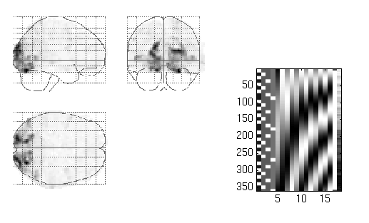
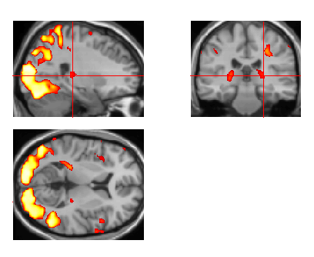
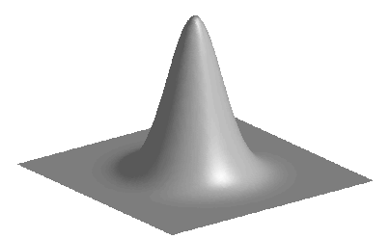
Image time-series
Spatial filter
Design matrix
Statistical Parametric Map
Realignment
Smoothing
General Linear Model
Statistical Inference
RFT
Normalisation
Anatomical reference
p <0.05
Parameter estimates

Slide 3
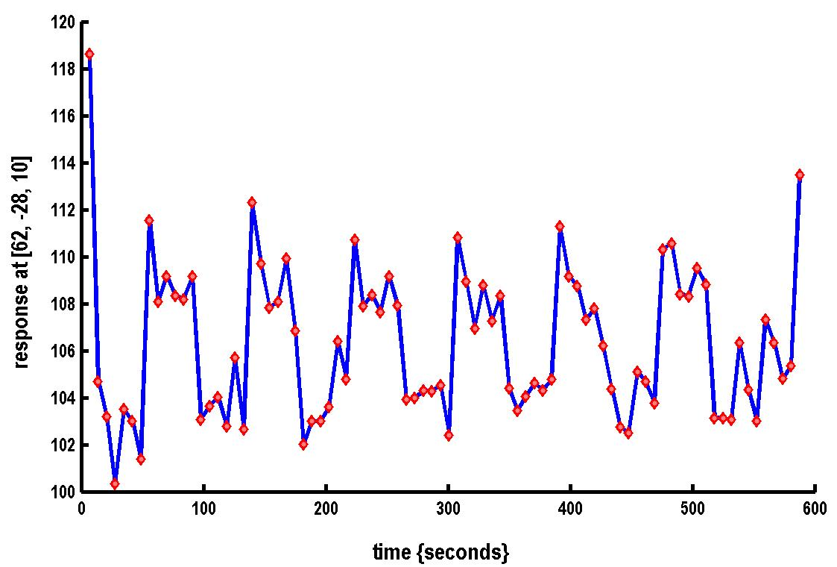

A very simple fMRI experiment
One session
Passive word listening
versus rest
7 cycles of
rest and listening
Blocks of 6 scans
with 7 sec TR
Stimulus function
Question: Is there a change in the BOLD response between listening and rest?

Slide 4
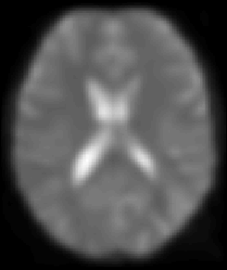
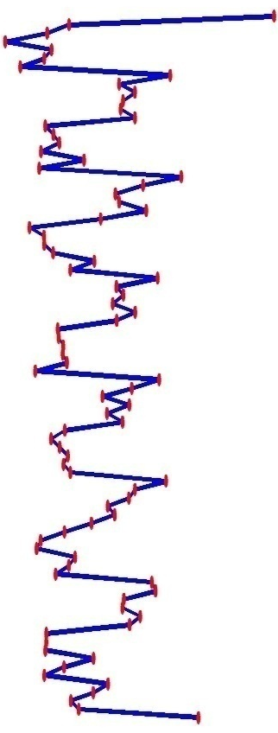
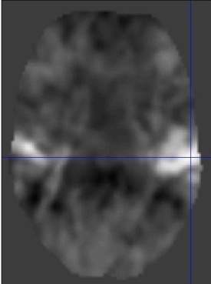
Voxel-wise time series analysis
Model
specification
Parameter
estimation
Time
Hypothesis
Statistic
Time
BOLD signal
single voxel
time series
SPM

Slide 5

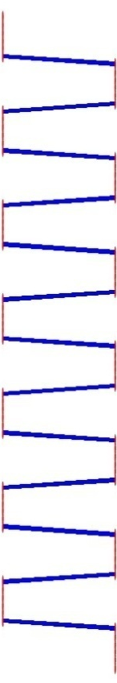

Single voxel regression model
error
=
β₁
+
β₂
+
Time
x₁
x₂
e
BOLD signal

Slide 6
Mass-univariate analysis: voxel-wise GLM
X
y
+
=
Model is specified by
Design matrix X
Assumptions about e
N: number of scans
p: number of regressors
The design matrix embodies all available knowledge about experimentally controlled factors and potential confounds.

Slide 7
GLM: a flexible framework for parametric analyses
one sample t-test
two sample t-test
paired t-test
Analysis of Variance (ANOVA)
Analysis of Covariance (ANCoVA)
correlation
linear regression
multiple regression

Slide 8



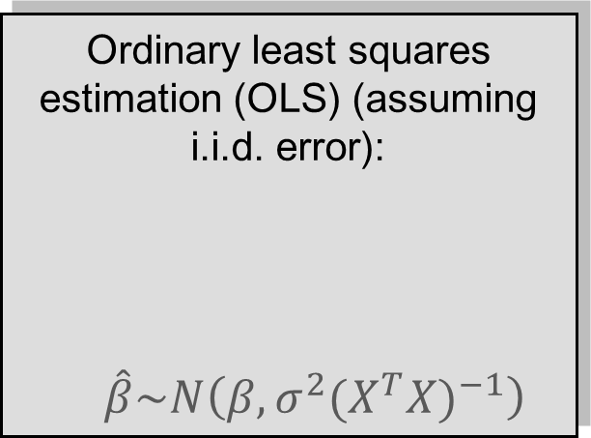
Parameter estimation
Objective:
estimate parameters to minimize
=
+
Ordinary least squares estimation (OLS) (assuming i.i.d. error):
$\hat{β}\sim N\left(β,σ^{2}{(X^{T}X)}^{−1}\right)$
y
X

Slide 9
A geometric perspective on the GLM
Smallest errors (shortest error vector)
when e is orthogonal to X
y
e
x₂
O
x₁
Design space defined by X
Ordinary Least Squares (OLS)

Slide 10
Problems of this model with fMRI time series
The BOLD response has a delayed and dispersed shape.
The BOLD signal includes substantial amounts of low-frequency noise (eg due to scanner drift).
Due to breathing, heartbeat & unmodeled neuronal activity, the errors are serially correlated. This violates the assumptions of the noise model in the GLM.

Slide 11
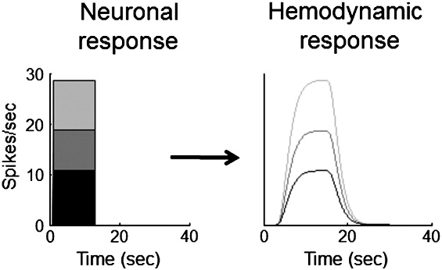
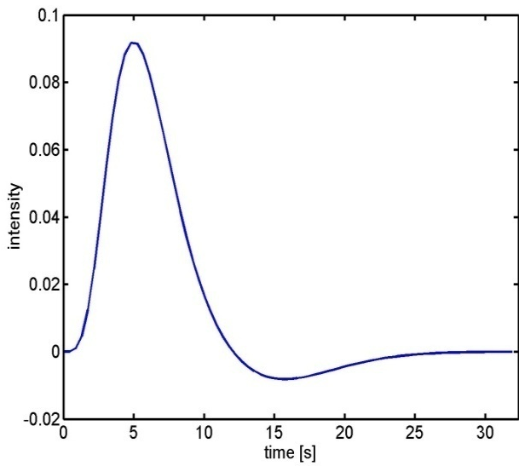
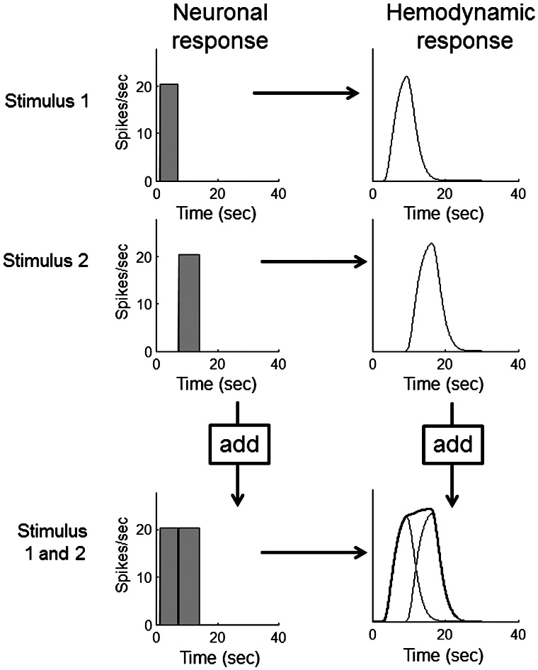
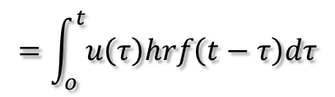

Problem 1: BOLD response
Hemodynamic response function (HRF):
Scaling
Shift invariance
Linear time-invariant (LTI) system:
u(t)
hrf(t)
x(t)
Convolution operator:
$$x\left(t\right)=u\left(t\right)∗hrf\left(t\right)$$
Additivity
$$=\int_{o}^{t}{u\left(τ\right)hrf\left(t−τ\right)dτ}$$
Boynton et al, NeuroImage, 2012.

Slide 12
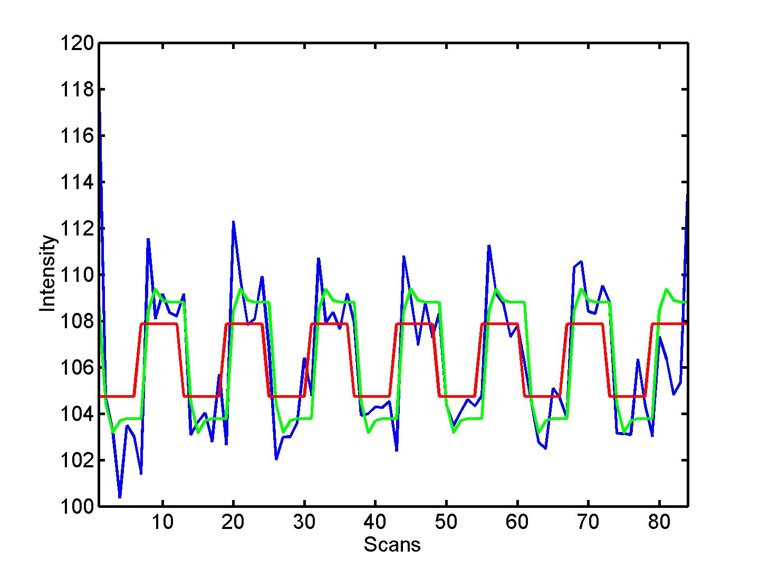


Convolution model of the BOLD response
Convolve stimulus function with a canonical hemodynamic response function (HRF):
⊗ HRF

Slide 13
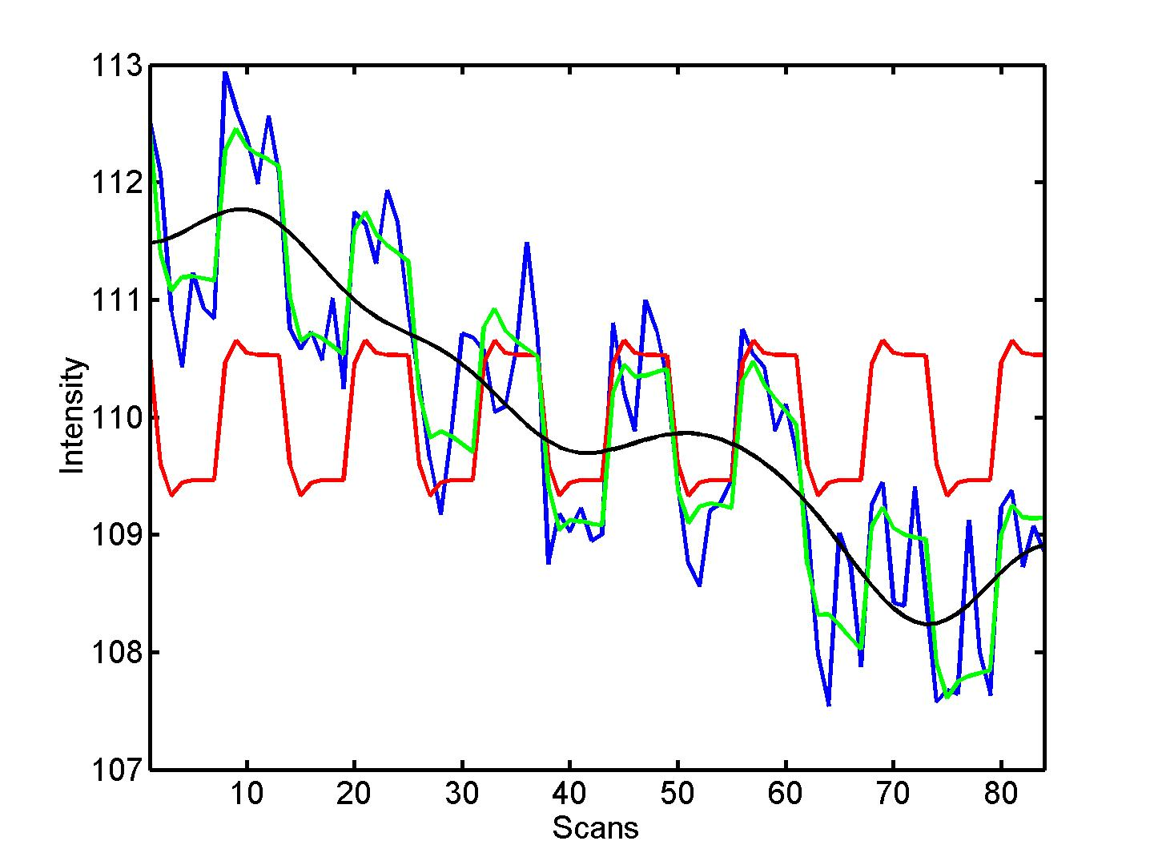

Problem 2: Low-frequency noise Solution: High pass filtering
blue = data
black = mean + low-frequency drift
green = predicted response, taking into account low-frequency drift
red = predicted response, NOT taking into account low-frequency drift
discrete cosine transform (DCT) set

Slide 14
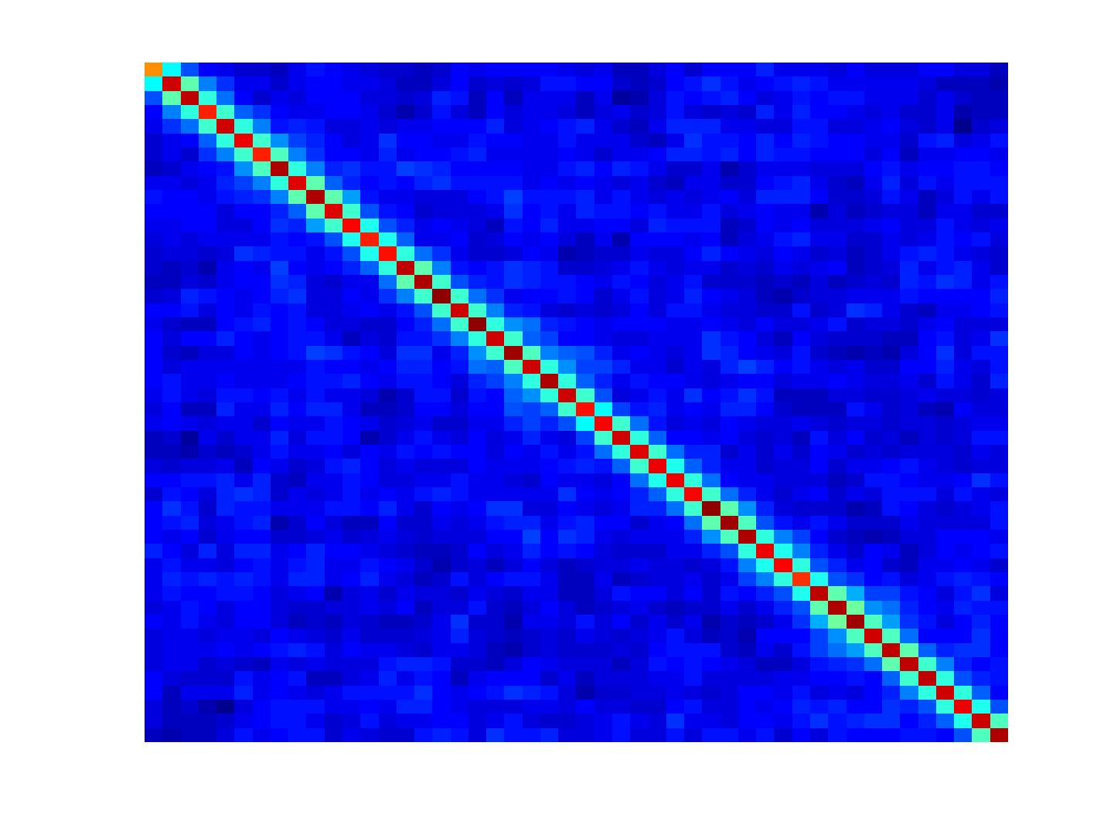
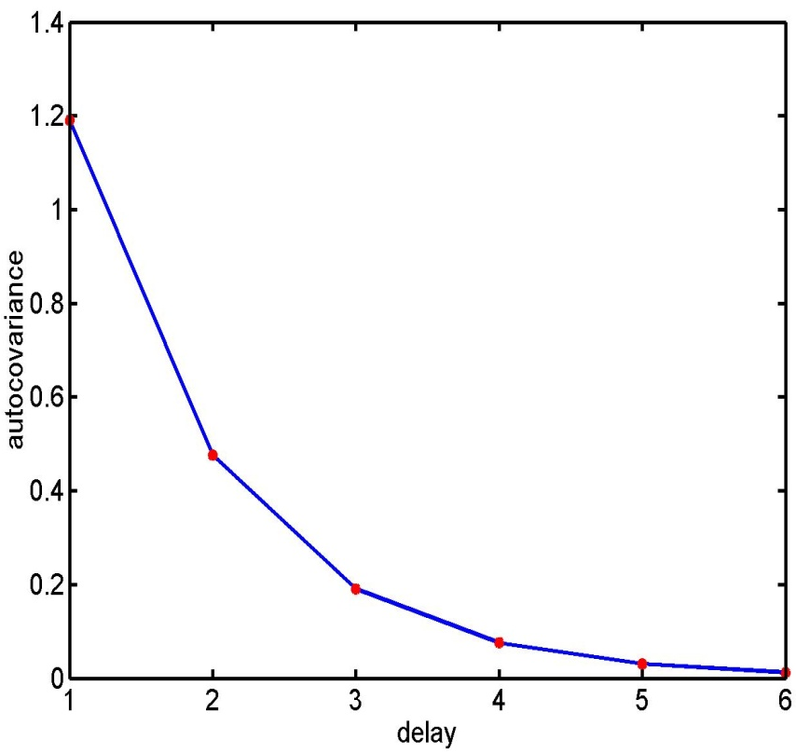
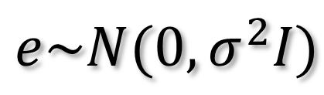
Problem 3: Serial correlations
i.i.d:
$$e\sim N(0,σ^{2}I)$$
autocovariance
function

Slide 15
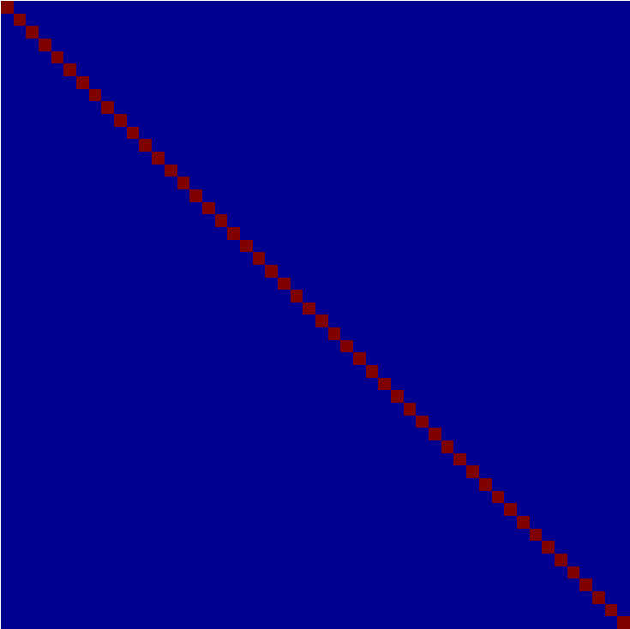



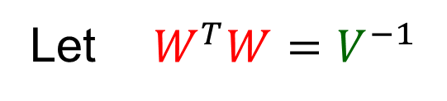




$$V$$
$$y =Xβ+e e\sim 𝒩(0, σ^{2}V)$$
Let ${ W}^{T}W=V^{−1}$
$$Wy=WXβ+We We\sim 𝒩(0,{σ^{2}W}^{T}VW)$$
$$W$$
$$y_{s}$$
$$X_{s}$$
$$e_{s}$$
$$I$$
Solution : Whitening the data
BUT this requires an estimation of V
$$W^{T}VW$$
Equivalent to the Weighted Least Square (WLS) estimator

Slide 16
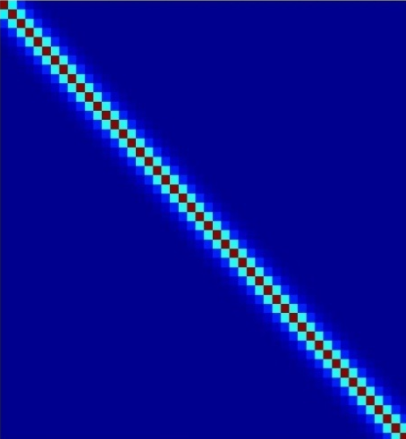
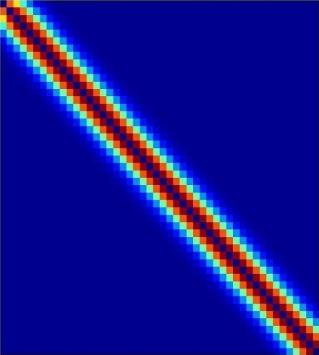
Multiple covariance components
enhanced noise model at voxel i
error covariance components Q and hyperparameters λ
V
Q₁
Q₂
=
λ₁
+ λ₂
Estimation of hyperparameters λ with ReML (Restricted Maximum Likelihood).

Slide 17

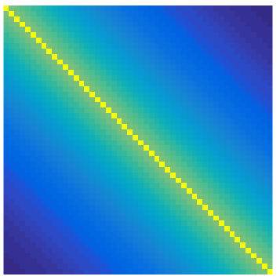
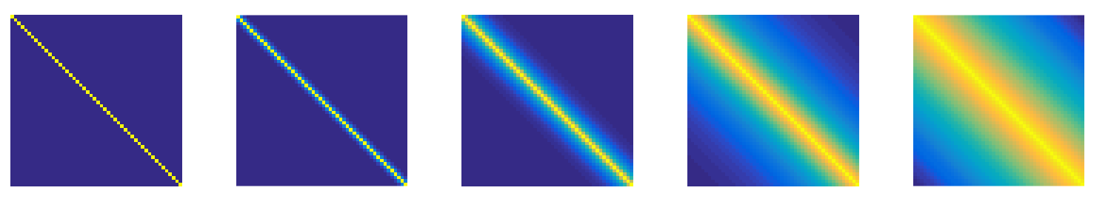










The AR(1)+white noise model may not be enough for short TR (<1.5 s)
$$Q_{1}$$
$$Q_{2}$$
$$Q_{3}$$
$$Q_{4}$$
$$Q_{5}$$
V
=$λ_{1}$
+$λ_{2}$
+$λ_{3}$
+$λ_{4}$
+$λ_{5}$
+ …
The flexibility of the ReML enables the use of any number of components of any shape

Slide 18
Summary
Mass univariate approach.
Fit GLMs with design matrix, X, to data at different points in space to estimate local effect sizes,
GLM is a very general approach
Hemodynamic Response Function
High pass filtering
Temporal autocorrelation

Slide 19
A mass-univariate approach
Summary
Time

Slide 20
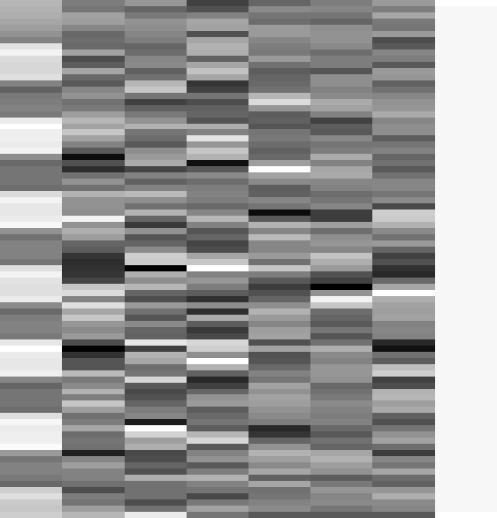

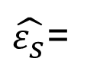
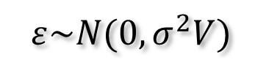





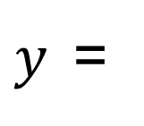
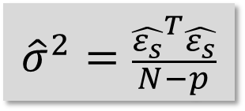
Estimation of the parameters
Summary
noise assumptions:
$$ε\sim N(0,σ^{2}V)$$
Pre-whitening: $X_{s}=WX y_{s}=Wy ε_{s}=Wε$
$$\hat{β}={(X_{s}^{T}X_{s})}^{−1}X_{s}^{T}y_{s}$$
$${\hat{β}}_{1}=3.9831$$
$${\hat{β}}_{2−7}=\{0.6871, 1.9598, 1.3902, 166.1007, 76.4770, −64.8189\}$$
$$β$$
$${\hat{β}}_{8}=131.0040$$
$y$=
$$+ε$$
$\hat{ε_{s}}$=
$${\hat{σ}}^{2}=\frac{{\hat{ε_{s}}}^{T}\hat{ε_{s}}}{N−p}$$
$$\hat{β}\sim N\left(β,σ^{2}{(X_{s}^{T}X_{s})}^{−1}\right)$$

Slide 21
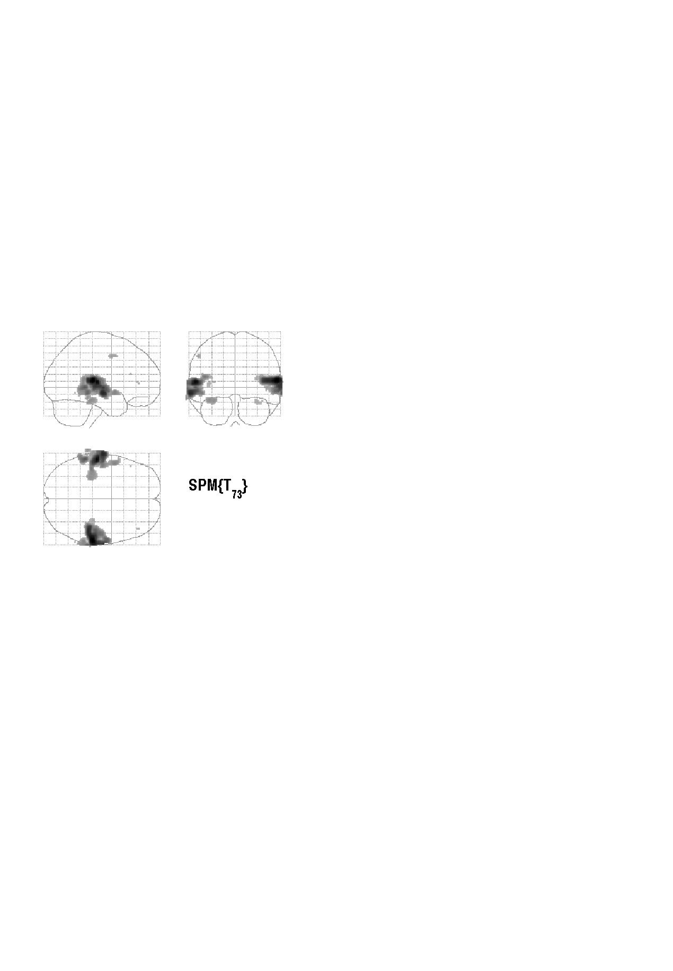


Contrasts & statistical parametric maps
c = 1 0 0 0 0 0 0 0 0 0 0
Q: activation during listening ?
Null hypothesis:

Slide 22
References
Statistical parametric maps in functional imaging: a general linear approach, K.J. Friston et al, Human Brain Mapping, 1995.
Analysis of fMRI time-series revisited – again, K.J. Worsley and K.J. Friston, NeuroImage, 1995.
The general linear model and fMRI: Does love last forever?, J.-B. Poline and M. Brett, NeuroImage, 2012.
Linear systems analysis of the fMRI signal, G.M. Boynton et al, NeuroImage, 2012.

